Slide 1
Transforming Juvenile– Diversionary Programs
HARRIS COUNTY, TEXAS

Slide 2
Paradigm Shift - 2018
Reducing the juvenile footprint in Court
Be able to concentrate on the more serious cases
Be able to resolve the filed cases in a more timely manner
Expansion of Diversionary Programs
Be able to get the youth services quicker
Be able to keep it off the youth’s record

Slide 3
Diversion Programs
Notes:
Juvie 2.0 – trend is rising for Diversion Programs, where appropriate. It gives an immediate response for the criminal conduct. Studies have shown that the juvenile brain isn’t fully developed and so treating completely like an adult is not always appropriate. Also, studies have shown that being a part of the juvie system can be detrimental and cause receidivism in children who would not have otherwise been in the system.

Slide 4
Expansion of Diversionary Programs
Juvenile Marijuana Diversion
BASE Program
____________________
Second Chance Diversion 180
FIRST Program

Slide 5
Pre-Arrest Programs
Juvenile Marijuana Diversion
BASE Program

Slide 6
Juvenile Marijuana Diversion
Section 52.03 of the Family Court
Disposition without Referral to court

Slide 7
Juvenile Marijuana Diversion Partners

Slide 8
Allowed by Law
Authorized by Family Code
Approved by Juvenile Board

Slide 9
Disposition w/o Referral to Court (FC 52.03)
Law Enforcement Officer may dispose of the case without referral to juvenile court or charging
Has to be adopted by the Juvenile Board
Cannot keep the child in law enforcement custody
May include a referral to another agency and a brief conversation with the child and their guardian

Slide 10
No Processing
No AFIS
No Booking Photo

Slide 11
No Juvenile Detention
Officer will seize Cannabis
Return Youth to Parents

Slide 12
Juvenile Probation will contact Guardians
Offer Diversion
Schedule Class

Slide 13
Final Steps
Upon successful completion of the Class
If rejects Diversion or fails to attend the Class
HCDA will file a Motion to Destroy all Law Enforcement Records that were generated
HCDA will file a Motion Destroy the Cannabis
HCDA will notify initial officer that the youth failed to do Diversion
Officer can have the Cannabis tested
If the THC is higher than 0.3% then charges may be authorized

Slide 14
B.A.S.E. Program
Building Appropriate sexual education

Slide 15
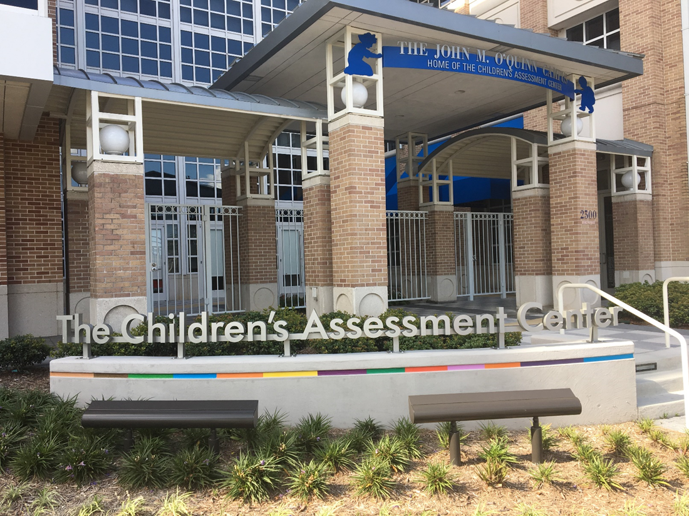
B.A.S.E. Partnership

Slide 16
B.A.S.E. Program
Began August 2018
9-12 month program
Goals of Treatment
Develop empathy for victim
Recognize offense cycle
Develop coping strategies
Gets youth and family education and therapy
Roughly 20% of the cases get BASE

Slide 18
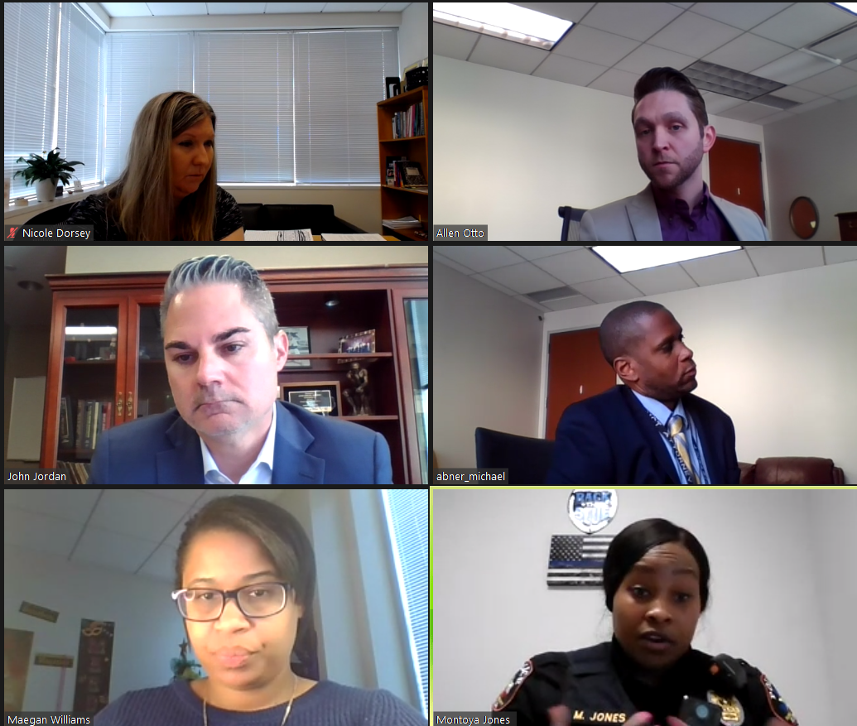
Sexual Abuse Panel
Officers present all sexual related cases involving juvenile
The committee has to agree to do one of the following:
File a petition.
Refer for further investigation.
Refer to Diversion Program (BASE)
Decline to file a petition.
If a petition is authorized, the officer has one week to apprehend the youth.

Slide 19
Post-Arrest Programs
Second Chance Diversion 180
FIRST Program

Slide 20
Second Chance Program
partners

Slide 21
First Offender Program (FC 52.031)
Established by the Juvenile Board
Includes all non-violent misdemeanors
Officer Must
Give Notice to Guardian that child taken into custody
Identify the Law Enforcement Agency
Describe Nature of the Program
State Child’s Refusal may = referral to juvenile court

Slide 22
Second Chance Program
Established 2009, Renamed 2019
All Misdemeanors
90% success rate
Recently expanded to include nonviolent felonies
Juvenile Chiefs screen for eligibility
Notes:
Pre-petition – only evidence is arrest record; not court records
“P” program – usually a class called Juvenile Consequences
87% success rate – juvenile does not get arrested for another charge before their 18th birthday

Slide 23
Diversion 180
Partners

Slide 24
Diversion 180 Eligibility
All Misdemeanors
Third Degree and State Jail Felonies
Often have already done Second Chance Program
Can get it more than once if subsequent cases are only misdemeanors

Slide 25
F.I.R.S.T. Program
Family intervention restorative services
of Texas

Slide 26
F.I.R.S.T. Partners

Slide 27
F.I.R.S.T. Program
Begin February 2019
Involves cases of the juvenile assaulting a parent, guardian, or sibling within the home
Includes criminal mischief and terroristic threat
Wraparound family treatment
Thru 2023– 1115 families in F.I.R.S.T. program
78% success rate

Slide 28
STATISTICS

Slide 29
Pre-Arrest Diversions

Slide 30
Juvenile Marijuana Diversion Program 2019 - 2023
Unsuccessful
Still in the
Program
Successful
Completion
Total
Referrals

Slide 31
Juvenile Marijuana Diversion Program 2019 - 2023
Unsuccessful
Still in the
Program
Successful
Completion
Total
Referrals

Slide 32
B.A.S.E. 2018 - 2023
Unsuccessful
Still in the
Program
Successful
Completion
Total
Referrals

Slide 33
B.A.S.E. 2018 - 2023
Unsuccessful
Still in the
Program
Successful
Completion
Total
Referrals

Slide 35
Second Chance 2020 - 2023
Unsuccessful
Still in the
Program
Successful
Completion
Total
Referrals

Slide 36
Second Chance 2020 - 2023
Unsuccessful
Still in the
Program
Successful
Completion
Total
Referrals

Slide 37
Diversion 180 2020 - 2023
Unsuccessful
Still in the
Program
Successful
Completion
Total
Referrals

Slide 38
Diversion 180 2020 - 2023
Unsuccessful
Still in the
Program
Successful
Completion
Total
Referrals

Slide 39
F.I.R.S.T. 2020 - 2023
Unsuccessful
Still in the
Program
Successful
Completion
Total
Referrals

Slide 40
F.I.R.S.T. 2020 - 2023
Unsuccessful
Still in the
Program
Successful
Completion
Total
Referrals
78%

Slide 42
But Has It Worked?

Slide 43
Total New Referrals– Calendar Year
2017 Total = 6165 Misd = 70% Felony = 30% Robb. = 404 | 2019 Total = 6150 Misd = 64% Felony = 36% Robb. = 468 | 2021 Total = 3402 Misd = 50% Felony = 50% Robb. = 419 | 2023 Total = 5701 Misd = 62% Felony = 38% Robb. = 292

Slide 44
(Non VOP) Juvenile Cases Filed 2017-2023

Slide 45
Total Petitions (Including VOP)-Docket Size
2017 Total = 6118 Non VOP = 5063 Misd = 65% Felony = 35% | 2019 Total = 4656 Non VOP = 3959 Misd = 57% Felony = 43% | 2021 Total = 1677 Non VOP = 1429 Misd = 21% Felony = 79% | 2023 Total = 2655 Non VOP = 2151 Misd = 28% Felony = 72%
Average Docket ~500 cases
First Setting = 2-4 weeks from petition

Slide 46
Questions?
Lisa Calligan
713-274-0045
calligan_lisa@DAO.HCTX.NET
Allen Otto
713-274-0035
Otto_Allen@DAO.HCTX.NET

Slide 47
